Slide 1


DEPARTMENT OF COMPUTER SCIENCE & ENGINEERING
Subject Name: Multimedia Technologies
Subject Code: (20CST-334/20ITT-334)
Lecture 1
Topics Covered: What is multimedia, Components of multimedia.
DISCOVER . LEARN . EMPOWER

Slide 2
Introduction to Multimedia :-
Multimedia is an interactive media and provides multiple ways to represent information to the user in a powerful manner. It provides an interaction between users and digital information. It is a medium of communication. Some of the sectors where multimedia's is used extensively are education, training, reference material, business presentations, advertising and documentaries.

Slide 3
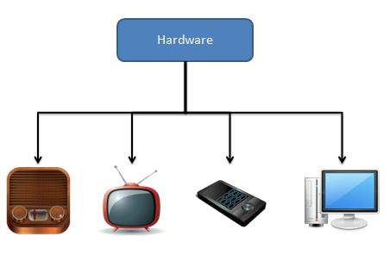
Introduction to Multimedia :-
Multimedia as name suggests is the combination of Multi and Media that is many types of media (hardware/software) used for communication of information.

Slide 4
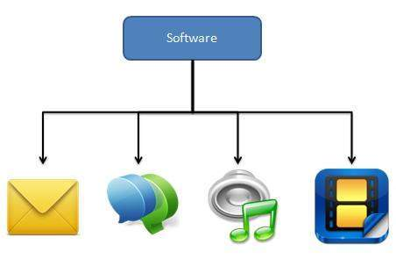
Introduction to Multimedia :-

Slide 5
Components of Multimedia
Following are the common components of multimedia:
Text- All multimedia productions contain some amount of text. The text can have various types of fonts and sizes to suit the profession presentation of the multimedia software.
Graphics- Graphics make the multimedia application attractive. In many cases people do not like reading large amount of textual matter on the screen. Therefore, graphics are used more often than text to explain a concept, present background information etc. There are two types of Graphics:
Bitmap images- Bitmap images are real images that can be captured from devices such as digital cameras or scanners. Generally bitmap images are not editable. Bitmap images require a large amount of memory.
Vector Graphics- Vector graphics are drawn on the computer and only require a small amount of memory. These graphics are editable.

Slide 6
Components of Multimedia
Audio- A multimedia application may require the use of speech, music and sound effects. These are called audio or sound element of multimedia. Speech is also a perfect way for teaching. Audio are of analog and digital types. Analog audio or sound refers to the original sound signal. Computer stores the sound in digital form. Therefore, the sound used in multimedia application is digital audio.

Slide 7
Components of Multimedia
Video- The term video refers to the moving picture, accompanied by sound such as a picture in television. Video element of multimedia application gives a lot of information in small duration of time. Digital video is useful in multimedia application for showing real life objects. Video have highest performance demand on the computer memory and on the bandwidth if placed on the internet. Digital video files can be stored like any other files in the computer and the quality of the video can still be maintained. The digital video files can be transferred within a computer network. The digital video clips can be edited easily.

Slide 8
Components of Multimedia
Full-motion video, such as the images depicted in a television, can add even more than to a multimedia application. Although full-motion video may sound similar an perfect way to add a powerful message to a multimedia application, it is no where near the quality you would anticipate after watching television. Full-motion video is still in its occurrence stages on PCs, and it is constricted in resolution and size. Even with precocious methods of data compression, full-motion video can suck up hard disk space faster than waterfalls when poured out of a bucket.

Slide 9
Components of Multimedia
Animation- Animation is a process of making a static image look like it is moving. An animation is just a continuous series of still images that are displayed in a sequence. The animation can be used effectively for attracting attention. Animation also makes a presentation light and attractive. Animation is very popular in multimedia application

Slide 10
Reference and text books:-
TEXT BOOKS
Tay Vaughan, “Multimedia making it work”, Tata McGraw-Hill, 2008.
Rajneesh Aggarwal & B. B Tiwari, “Multimedia Systems”, Excel Publication, New Delhi, 2007.
Li & Drew, “Fundamentals of Multimedia”, Pearson Education, 2009.
REFERENCE BOOKS
Parekh Ranjan, “Principles of Multimedia”, Tata McGraw-Hill, 2007
Anirban Mukhopadhyay and Arup Chattopadhyay, “Introduction to Computer Graphics and Multimedia”, Second Edition, Vikas Publishing House.

Slide 11
Any query ??

Slide 12
Thank you

